Slide 1
CIS CONTROL 15: WIRELESS ACCESS CONTROL-I
WIRELESS ACCESS CONTROL

Slide 2
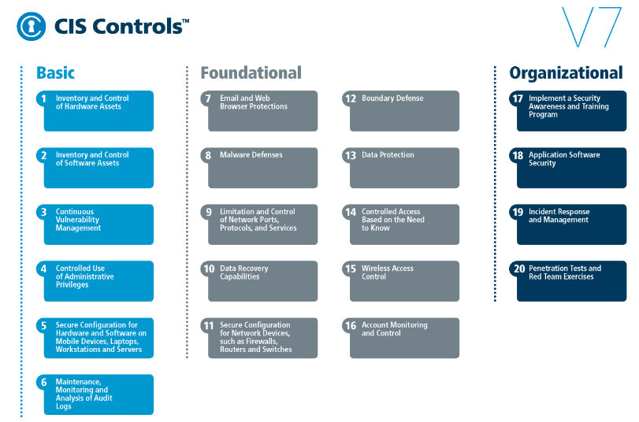
CIS CONTROL 15: WIRELESS ACCESS CONTROL-I
https://www.cisecurity.org/controls/

Slide 3
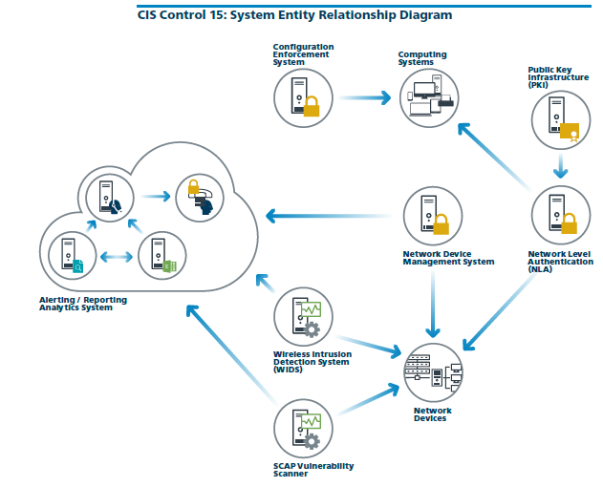
CIS CONTROL 15: WIRELESS ACCESS CONTROL-I
https://www.cisecurity.org/controls/

Slide 4
CIS CONTROL 15: WIRELESS ACCESS CONTROL-I
15.1: Maintain an Inventory of Authorized Wireless Access Points
Maintain an inventory of authorized wireless access points connected to the wired network.

Slide 5
CIS CONTROL 15: WIRELESS ACCESS CONTROL-I
15.2: Detect Wireless Access Points Connected to the Wired Network
Configure network vulnerability scanning tools to detect and alert on unauthorized wireless access points connected to the wired network.

Slide 6
CIS CONTROL 15: WIRELESS ACCESS CONTROL-I
15.3: Use a Wireless Intrusion Detection System
Use a wireless intrusion detection system (WIDS) to detect and alert on unauthorized wireless access points connected to the network.

